Slide 1
Discrete Fourier transform (DFT)
DFT is used in approximating the spectrum for a finite length sequence.
DTFT is good for theoretical spectrum analysis of digital signal but not good for computer-aided analysis.
DFT provides practical approach to numerical computation of DTFT for a finite length sequence.
Also, we may split an input signal in sets of N samples and do analysis for each set (segment or frame) separately.

Slide 2
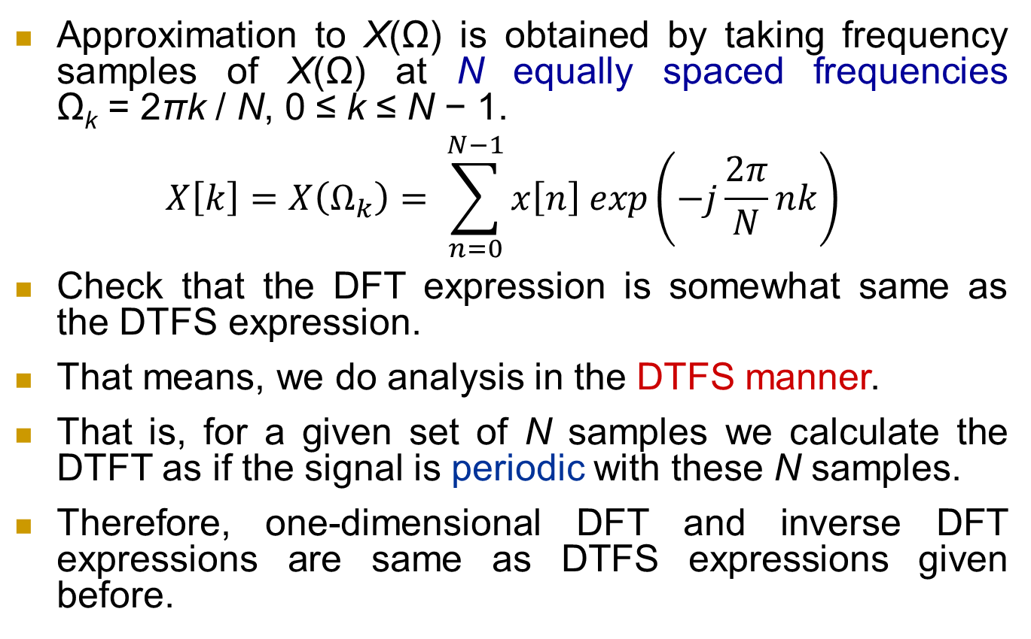
DFT continued
Approximation to X(Ω) is obtained by taking frequency samples of X(Ω) at N equally spaced frequencies Ω_{k} = 2πk / N, 0 ≤ k ≤ N − 1.
$$X\left[k\right]=X\left(Ω_{k}\right)= \sum_{n=0}^{N−1}{x\left[n\right] exp\left(−j\frac{2π}{N}nk\right) }$$
Check that the DFT expression is somewhat same as the DTFS expression.
That means, we do analysis in the DTFS manner.
That is, for a given set of N samples we calculate the DTFT as if the signal is periodic with these N samples.
Therefore, one-dimensional DFT and inverse DFT expressions are same as DTFS expressions given before.

Slide 3
Sampling in frequency
Discuss frequency sampling in the light of what we have studied in case of time sampling at Nyquist rate.
For better approximation we may go for M-point DFT (M > N), as if taking an M-length sequence created by zero padding to the given N-length sequence – discuss in the light of time sampling at a rate greater than Nyquist rate.
N-length sequence
DTFT
Freq. continuous Spectrum
from −π to +π
Periodic repetition
DFT
Freq. sampling
Periodic signal with period N
Discrete-frequency spectrum
DTFS

Slide 4
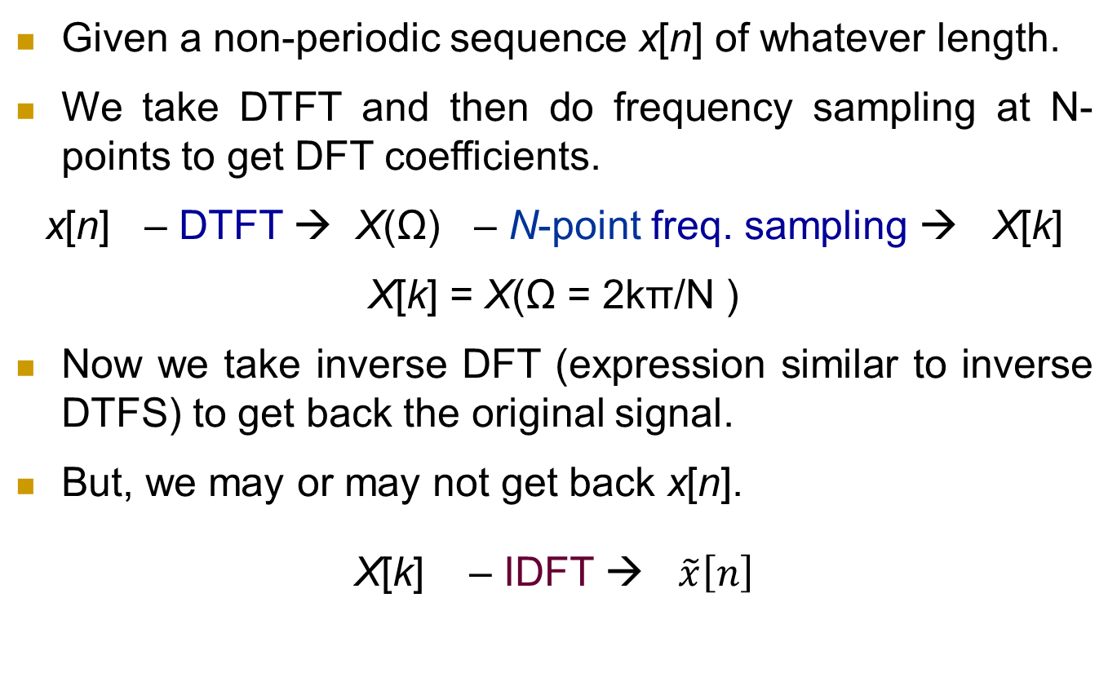
Signal recovery from DFT
Given a non-periodic sequence x[n] of whatever length.
We take DTFT and then do frequency sampling at N-points to get DFT coefficients.
x[n] – DTFT → X(Ω) – N-point freq. sampling → X[k]
X[k] = X(Ω = 2kπ/N )
Now we take inverse DFT (expression similar to inverse DTFS) to get back the original signal.
But, we may or may not get back x[n].
X[k] – IDFT → $\tilde{x}\left[n\right]$

Slide 5
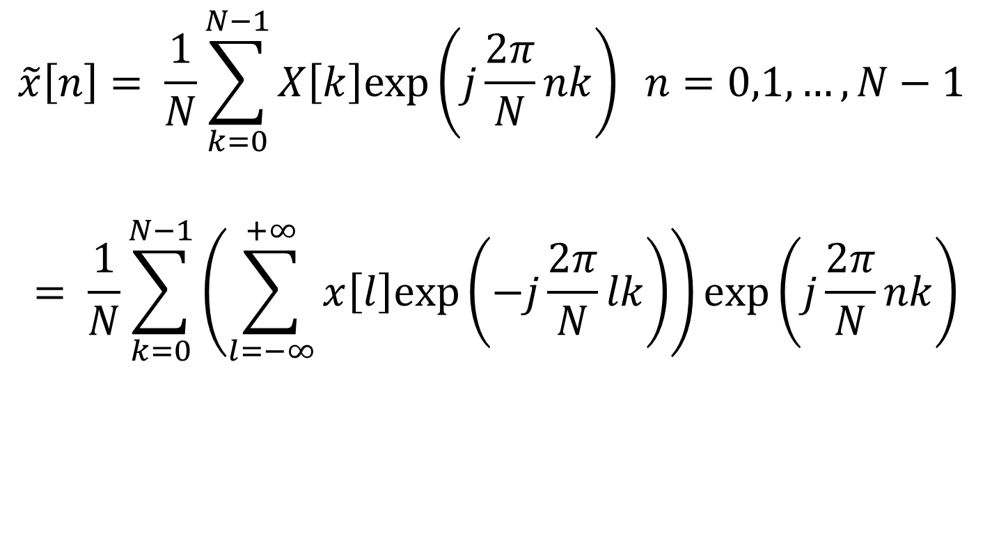
Signal recovery from DFT
$$\tilde{x}\left[n\right]= \frac{1}{N}\sum_{k=0}^{N−1}{X\left[k\right]exp\left(j\frac{2π}{N}nk\right) n=0,1, …, N−1}$$
$$= \frac{1}{N}\sum_{k=0}^{N−1}{\left(\sum_{l=−∞}^{+∞}{x\left[l\right]exp\left(−j\frac{2π}{N}lk\right)}\right)exp\left(j\frac{2π}{N}nk\right)}$$

Slide 6
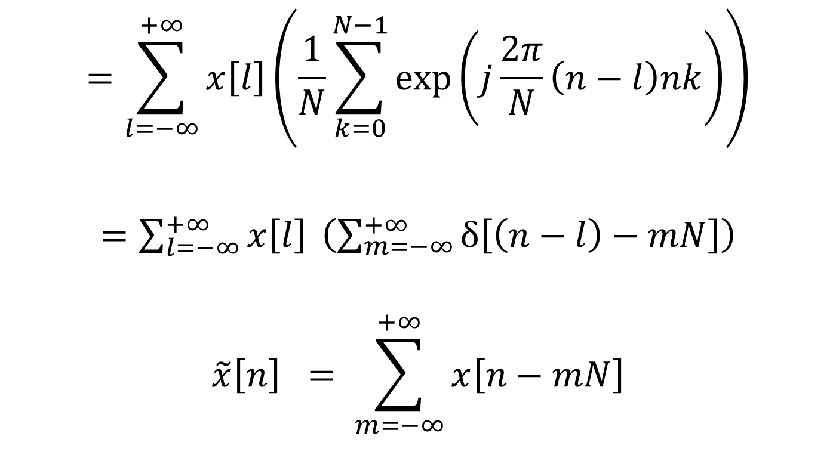
Signal recovery from DFT
$$=\sum_{l=−∞}^{+∞}{x\left[l\right]}\left(\frac{1}{N}\sum_{k=0}^{N−1}{exp\left(j\frac{2π}{N}\left(n−l\right)nk\right)}\right)$$
$=\sum_{l=−∞}^{+∞}{x\left[l\right]} \left(\sum_{m=−∞}^{+∞}{δ\left[\left(n−l\right)−mN\right]}\right)$
$$\tilde{x}\left[n\right] = \sum_{m=−∞}^{+∞}{x\left[n−mN\right]}$$

Slide 7
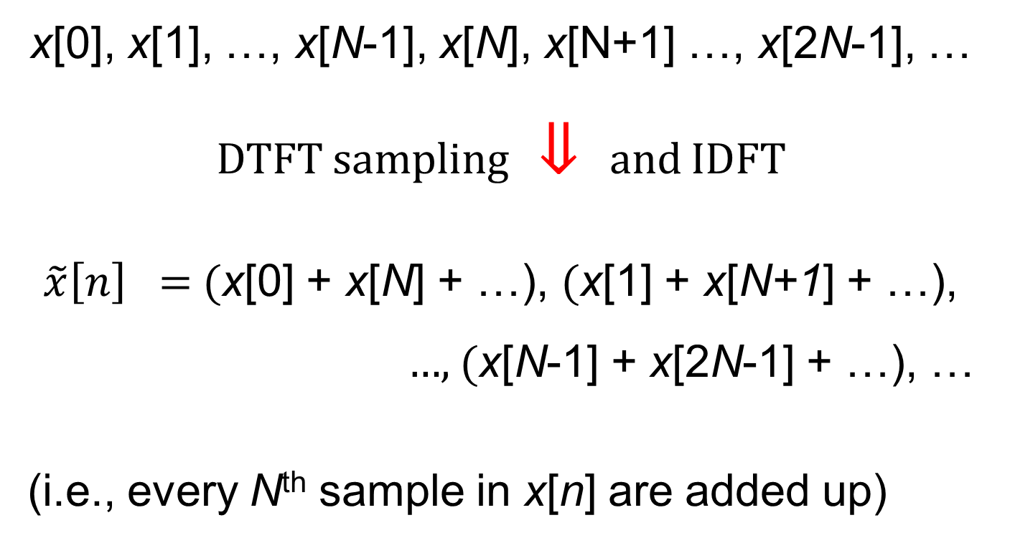
Signal recovery from DFT
x[0], x[1], …, x[N-1], x[N], x[N+1] …, x[2N-1], …
DTFT sampling ⇓ and IDFT
$\tilde{x}\left[n\right] =$ (x[0] + x[N] + …), (x[1] + x[N+1] + …),
…, (x[N-1] + x[2N-1] + …), …
(i.e., every N^{th} sample in x[n] are added up)

Slide 8
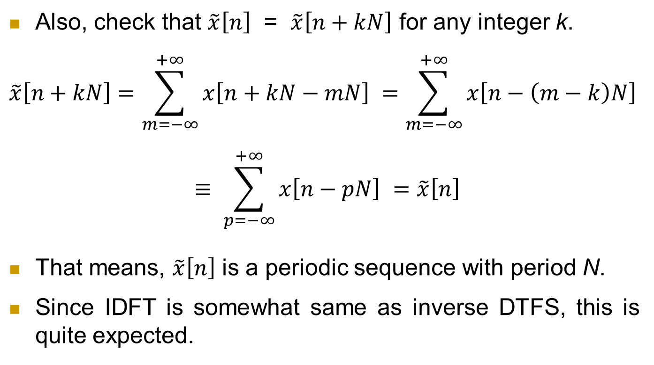
Signal recovery from DFT
Also, check that $\tilde{x}\left[n\right]$ = $\tilde{x}\left[n+kN\right]$ for any integer k.
$$\tilde{x}\left[n+kN\right]=\sum_{m=−∞}^{+∞}{x\left[n+kN−mN\right] }=\sum_{m=−∞}^{+∞}{x\left[n−\left(m−k\right)N\right]}$$
$$≡ \sum_{p=−∞}^{+∞}{x\left[n−pN\right] =\tilde{x}\left[n\right]}$$
That means, $\tilde{x}\left[n\right]$ is a periodic sequence with period N.
Since IDFT is somewhat same as inverse DTFS, this is quite expected.

Slide 9
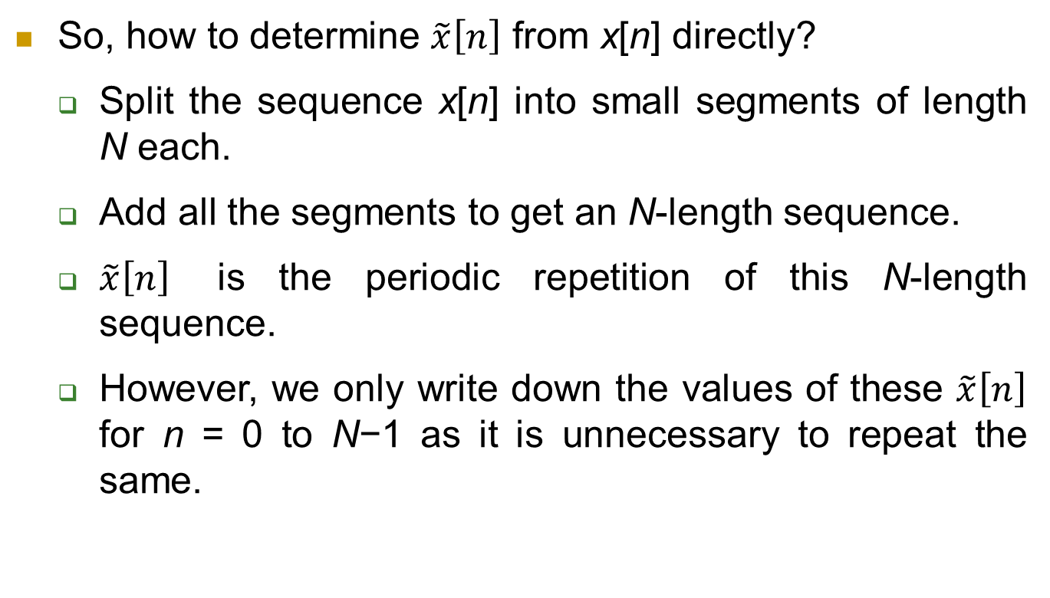
Signal recovery from DFT
So, how to determine $\tilde{x}\left[n\right]$ from x[n] directly?
Split the sequence x[n] into small segments of length N each.
Add all the segments to get an N-length sequence.
$\tilde{x}\left[n\right]$ is the periodic repetition of this N-length sequence.
However, we only write down the values of these $\tilde{x}\left[n\right]$ for n = 0 to N−1 as it is unnecessary to repeat the same.

Slide 10
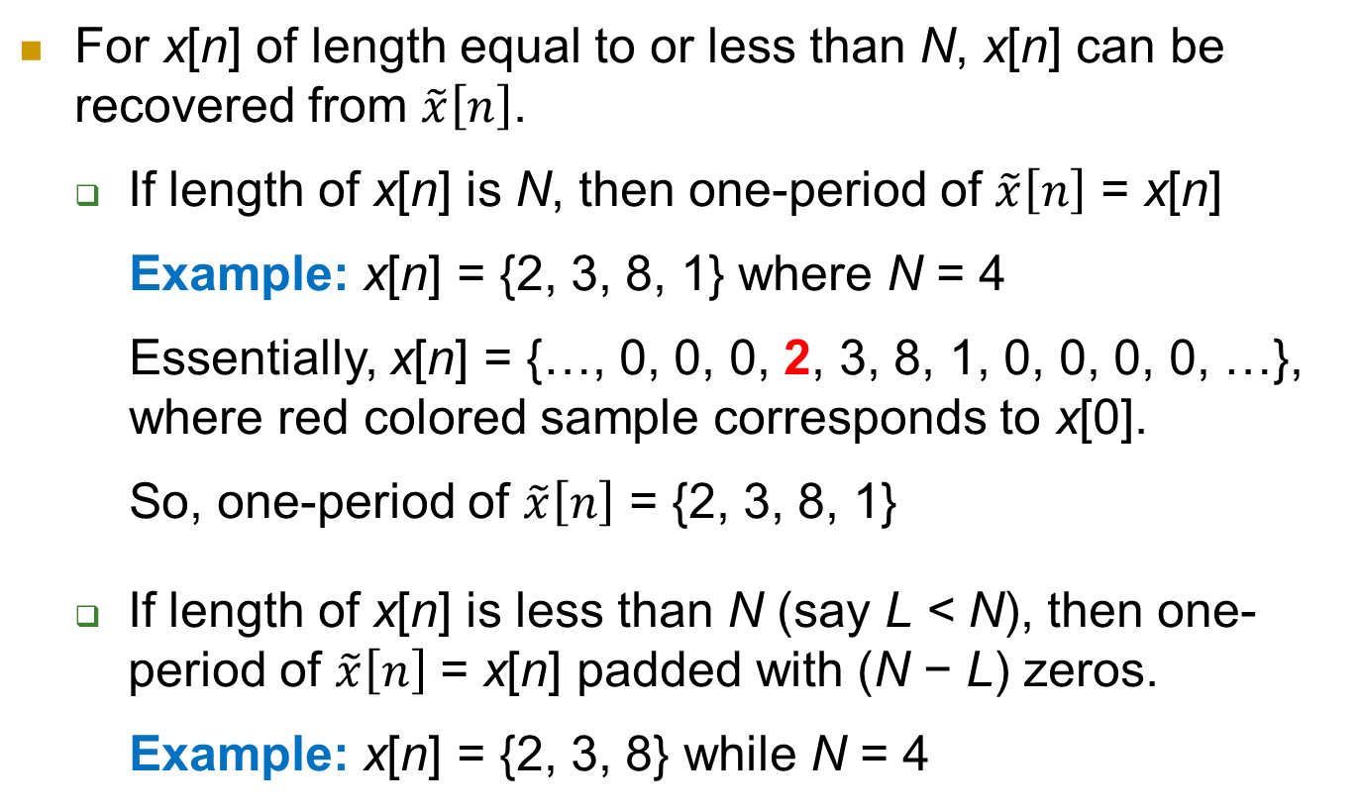
Signal recovery from DFT (contd.)
For x[n] of length equal to or less than N, x[n] can be recovered from $\tilde{x}\left[n\right]$.
If length of x[n] is N, then one-period of $\tilde{x}\left[n\right]$ = x[n]
Example: x[n] = {2, 3, 8, 1} where N = 4
Essentially, x[n] = {…, 0, 0, 0, 2, 3, 8, 1, 0, 0, 0, 0, …}, where red colored sample corresponds to x[0].
So, one-period of $\tilde{x}\left[n\right]$ = {2, 3, 8, 1}
If length of x[n] is less than N (say L < N), then one-period of $\tilde{x}\left[n\right]$ = x[n] padded with (N − L) zeros.
Example: x[n] = {2, 3, 8} while N = 4

Slide 11
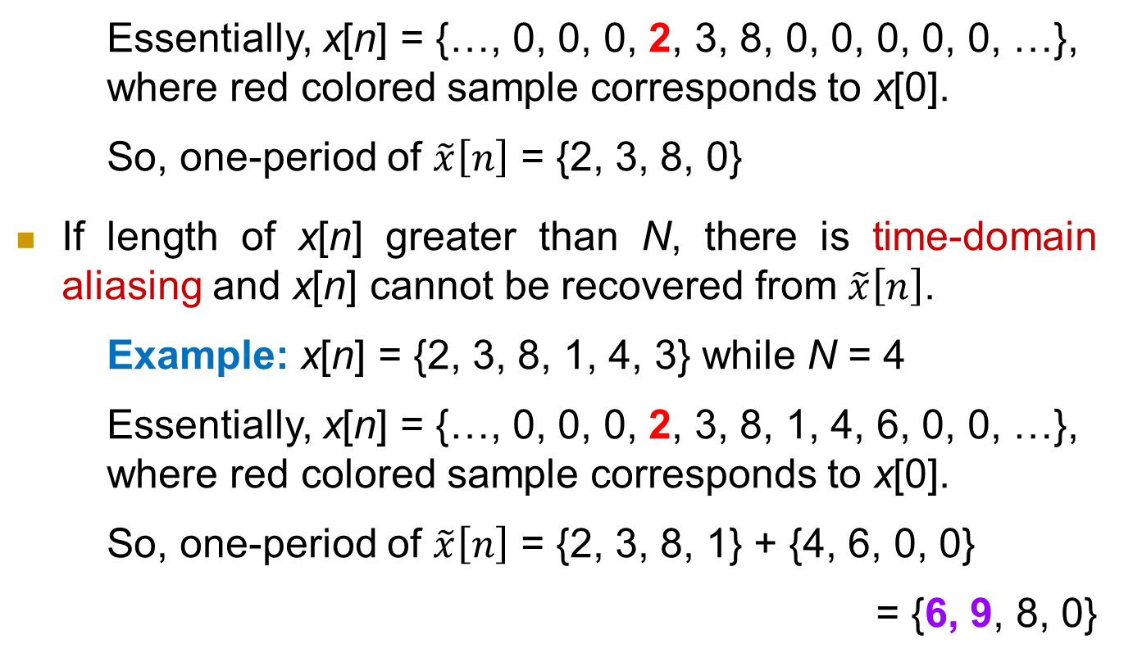
Signal recovery from DFT (contd.)
Essentially, x[n] = {…, 0, 0, 0, 2, 3, 8, 0, 0, 0, 0, 0, …}, where red colored sample corresponds to x[0].
So, one-period of $\tilde{x}\left[n\right]$ = {2, 3, 8, 0}
If length of x[n] greater than N, there is time-domain aliasing and x[n] cannot be recovered from $\tilde{x}\left[n\right]$.
Example: x[n] = {2, 3, 8, 1, 4, 3} while N = 4
Essentially, x[n] = {…, 0, 0, 0, 2, 3, 8, 1, 4, 6, 0, 0, …}, where red colored sample corresponds to x[0].
So, one-period of $\tilde{x}\left[n\right]$ = {2, 3, 8, 1} + {4, 6, 0, 0}
= {6, 9, 8, 0}

Slide 12
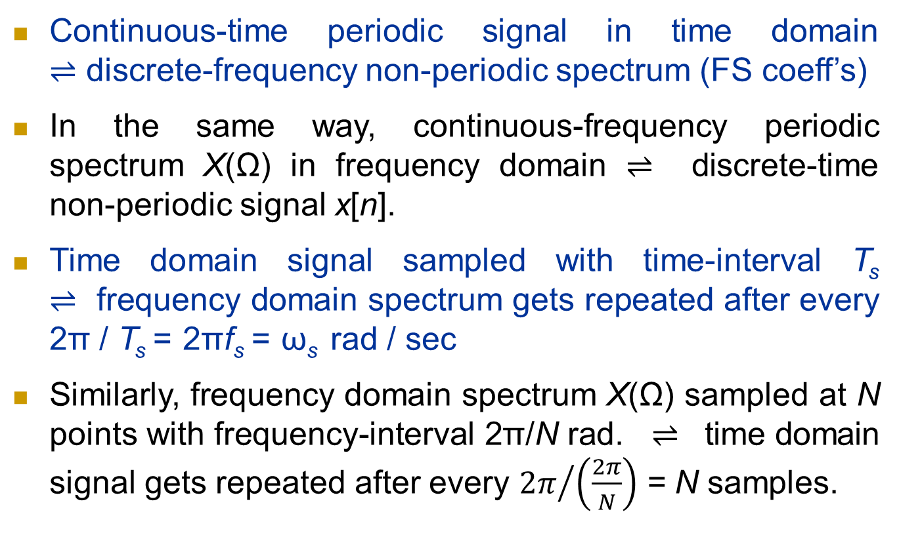
Correspondence to Sampling Theorem
Continuous-time periodic signal in time domain ⇌ discrete-frequency non-periodic spectrum (FS coeff’s)
In the same way, continuous-frequency periodic spectrum X(Ω) in frequency domain ⇌ discrete-time non-periodic signal x[n].
Time domain signal sampled with time-interval T_{s} ⇌ frequency domain spectrum gets repeated after every 2π / T_{s} = 2πf_{s} = ω_{s} rad / sec
Similarly, frequency domain spectrum X(Ω) sampled at N points with frequency-interval 2π/N rad. ⇌ time domain signal gets repeated after every ${2π}/{\left(\frac{2π}{N}\right)}$ = N samples.

Slide 13
Correspondence to Sampling Theorem
According to sampling theorem, ω_{s} ≥ total band-width of spectrum in rad/sec (incl. both pos. and neg. sides of the frequency band) is required for exact reconstruction of the original signal from the time-domain samples.
Similarly, here we require N ≥ total length of signal for exact recovery of the original signal from the frequency-domain samples (DFT coefficients), as checked before.
For ω_{s} > spectrum band-width (in rad/sec), we get a guard-band in between the repeated spectrum repetition.
Similarly, for N > signal length L, we get a guard-time in between the sequence x[n] repetition given by the zero padding of length N−L, as mentioned before.

Slide 14
Correspondence to Sampling Theorem
That is why, for an N-length sequence we generally do N-point DFT / IDFT.
However, we may go for N-point DFT even for an L-length sequence (L < N). The same has been said before that for an N-length sequence, we may go for M-point DFT (M > N) for better approximation of the spectrum.
We will discuss soon that this more-point DFT / IDFT is also required for carrying out convolution via multiplication in frequency domain – multiplying DFT coefficients and then taking IDFT of these DFT coefficient products.

Slide 15
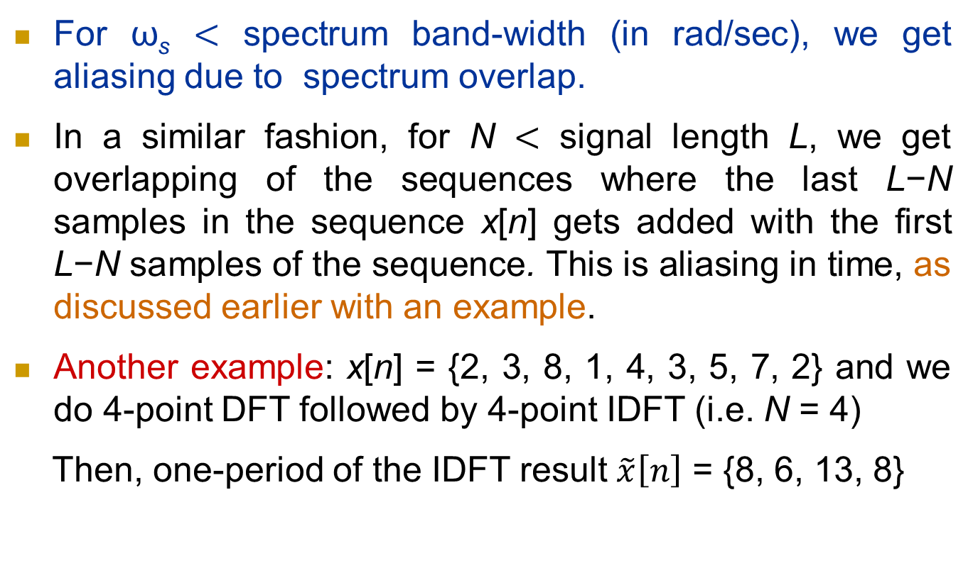
Correspondence to Sampling Theorem
For ω_{s} < spectrum band-width (in rad/sec), we get aliasing due to spectrum overlap.
In a similar fashion, for N < signal length L, we get overlapping of the sequences where the last L−N samples in the sequence x[n] gets added with the first L−N samples of the sequence. This is aliasing in time, as discussed earlier with an example.
Another example: x[n] = {2, 3, 8, 1, 4, 3, 5, 7, 2} and we do 4-point DFT followed by 4-point IDFT (i.e. N = 4)
Then, one-period of the IDFT result $\tilde{x}\left[n\right]$ = {8, 6, 13, 8}

Slide 16
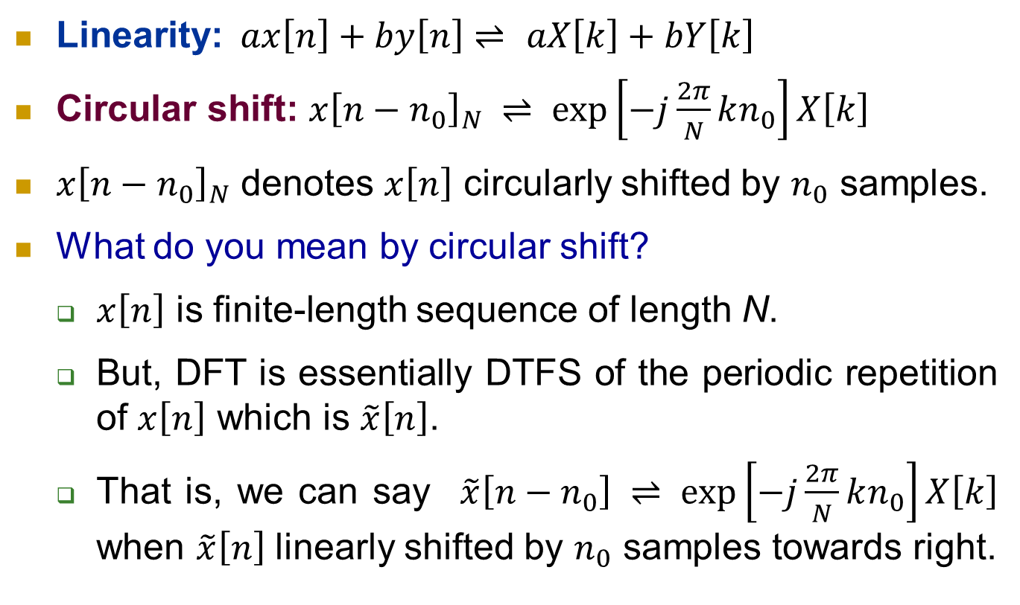
DFT properties
Linearity:$ax\left[n\right]+by\left[n\right]⇌$ $aX\left[k\right]+bY\left[k\right]$
Circular shift: ${x\left[n−n_{0}\right]}_{N} ⇌\exp\left[−j\frac{2π}{N}kn_{0}\right]X\left[k\right]$
${x\left[n−n_{0}\right]}_{N}$ denotes $x\left[n\right]$ circularly shifted by $n_{0}$ samples.
What do you mean by circular shift?
$x\left[n\right]$ is finite-length sequence of length N.
But, DFT is essentially DTFS of the periodic repetition of $x\left[n\right]$ which is $\tilde{x}\left[n\right]$.
That is, we can say $\tilde{x}\left[n−n_{0}\right] ⇌\exp\left[−j\frac{2π}{N}kn_{0}\right]X\left[k\right]$ when $\tilde{x}\left[n\right]$ linearly shifted by $n_{0}$ samples towards right.

Slide 17

DFT properties
How can we express $\tilde{x}\left[n−n_{0}\right]$ in terms of $x\left[n\right]$?
Write the N samples of $x\left[n\right]$ on a circle; our convention is to write in anti-clockwise direction for increasing n.
Shift (rotate) the samples in the same anti-clockwise direction corresponding to linear right-shift of $\tilde{x}\left[n\right]$.

Slide 18

DFT properties
What is ${x\left[n_{0}−n\right]}_{N}$?
${x\left[n_{0}−n\right]}_{N}$ = ${x\left[{−n+ n}_{0}\right]}_{N}$ ⇒ First circularly shift $x\left[n\right]$ clockwise by $n_{0}$ positions, followed by scaling by −1, i.e. reverse the order about the origin on the circle.
See for N = 6 and $n_{0}$ = 2 case
What is ${x\left[N−n\right]}_{N}$?
${x\left[N−n\right]}_{N}$
= $\left\{x\left[0\right],x\left[N−1\right], …,x\left[1\right]\right\}$

Slide 19
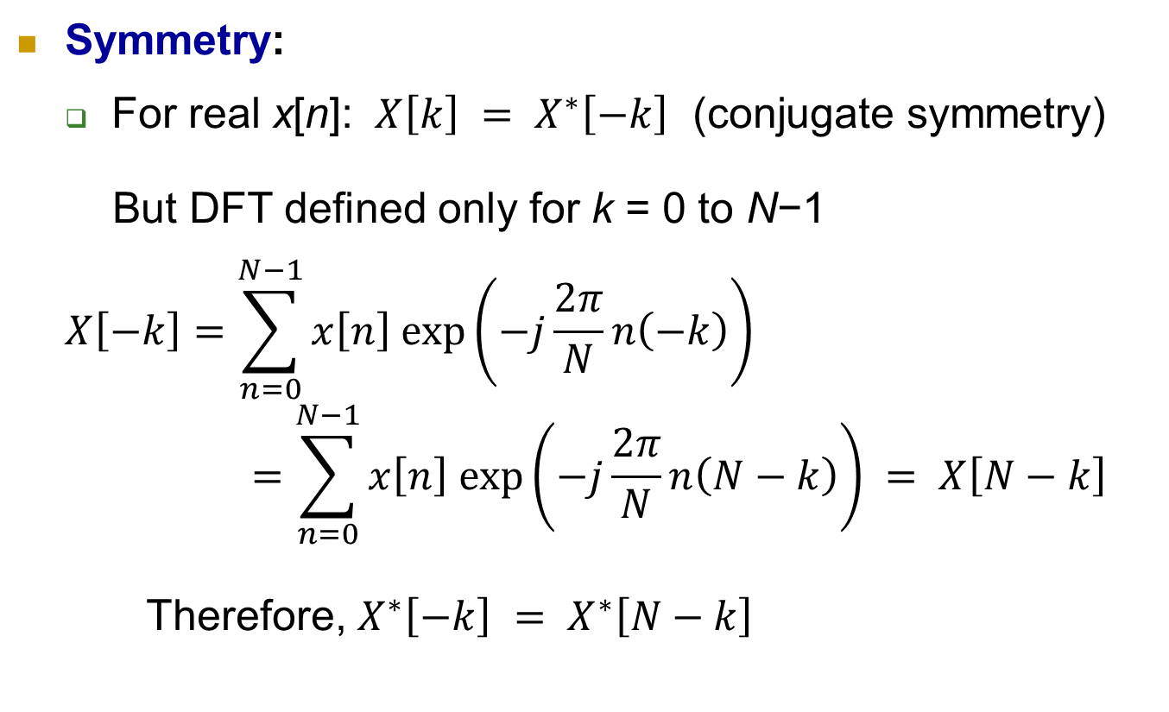
DFT properties
Symmetry:
For real x[n]: ${ X\left[k\right] = X}^{∗}\left[−k\right]$ (conjugate symmetry)
But DFT defined only for k = 0 to N−1
$$X\left[−k\right]=\sum_{n=0}^{N−1}{x\left[n\right] exp\left(−j\frac{2π}{N}n\left(−k\right)\right) }$$
$$=\sum_{n=0}^{N−1}{x\left[n\right] exp\left(−j\frac{2π}{N}n\left(N−k\right)\right) = X\left[N−k\right]}$$
Therefore, $X^{∗}\left[−k\right]$ ${ = X}^{∗}\left[N−k\right]$

Slide 20
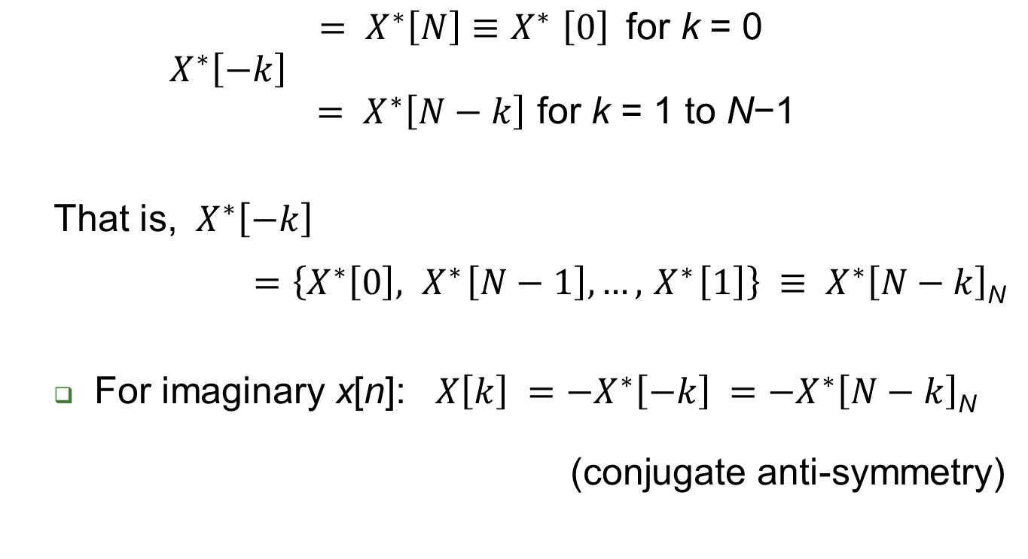
DFT properties
$X^{∗}\left[−k\right]$ $\begin{matrix}\begin{aligned}{ = X}^{∗}\left[N\right]{≡X}^{∗}\left[0\right] \text{for} \text{k}\text{ = }\text{0} \\ \end{aligned} \\ { = X}^{∗}\left[N−k\right] \text{for} \text{k}\text{ = 1 }\text{to} \text{N}\text{−1 }\end{matrix}$
That is, ${ X}^{∗}\left[−k\right]$
${ =\left\{X^{∗}\left[0\right],{ X}^{∗}\left[N−1\right], …,{ X}^{∗}\left[1\right]\right\} ≡ X}^{∗}\left[N−k\right]$_{N}
For imaginary x[n]: ${ X\left[k\right] =−X}^{∗}\left[−k\right]$ ${ =−X}^{∗}\left[N−k\right]$_{N}
(conjugate anti-symmetry)

Slide 21
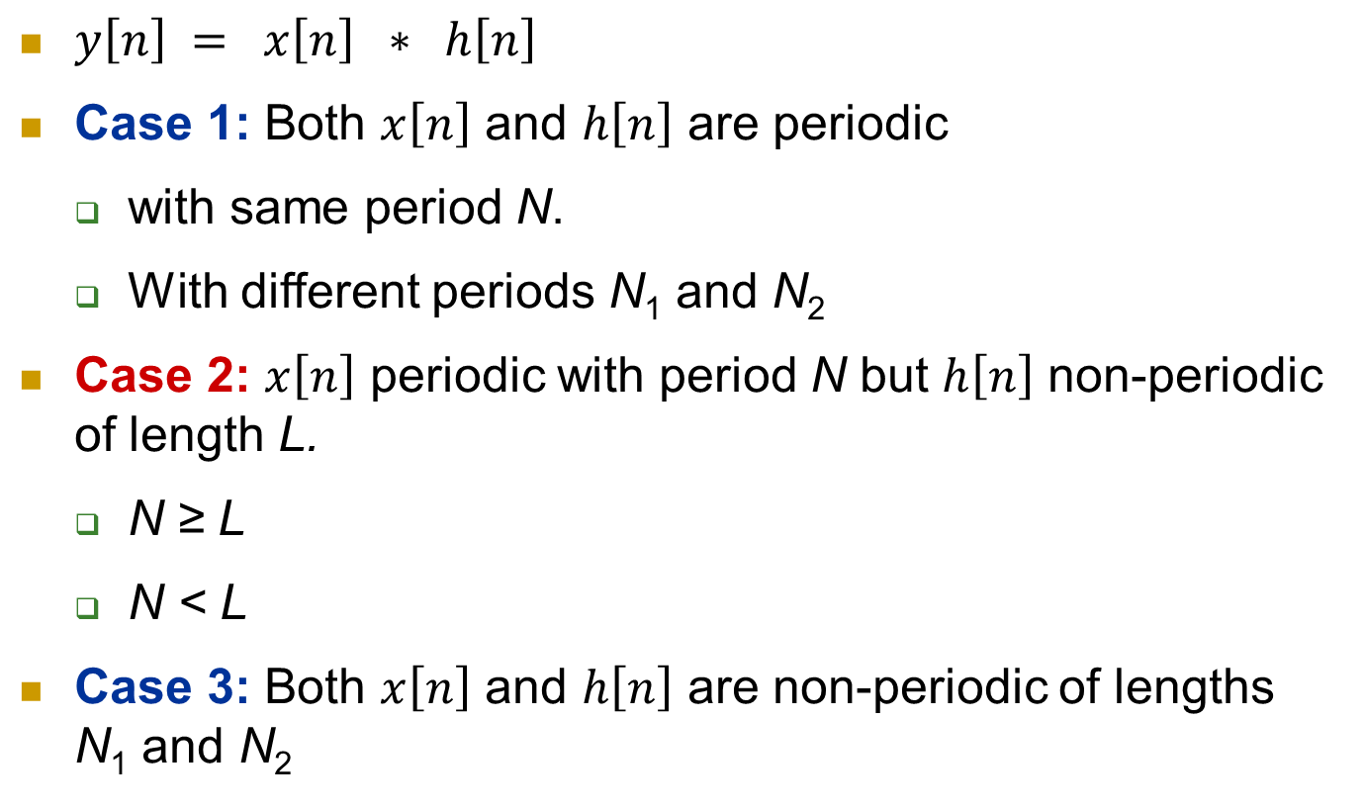
Convolution
$y\left[n\right] = x\left[n\right] ∗ h\left[n\right]$
Case 1: Both $x\left[n\right]$ and $h\left[n\right]$ are periodic
with same period N.
With different periods N₁ and N₂
Case 2: $x\left[n\right]$ periodic with period N but $h\left[n\right]$ non-periodic of length L.
N ≥ L
N < L
Case 3: Both $x\left[n\right]$ and $h\left[n\right]$ are non-periodic of lengths N₁ and N₂

Slide 22

Circular Convolution
Both $x\left[n\right]$ and $h\left[n\right]$ are periodic with same period N –
In general, $y\left[n\right]=x\left[n\right]∗h\left[n\right]= \sum_{l=−∞}^{+∞}{x\left[l\right]h\left[n−l\right]}$
Reflect $h\left[l\right]$ to get $h\left[−l\right]$ → multiply and add to get $y\left[0\right]$
Shift $h\left[−l\right]$ by n samples towards right for positive n and towards left for negative n to get $h\left[n−l\right]$ → multiply and add to get $y\left[n\right]$.

Slide 23
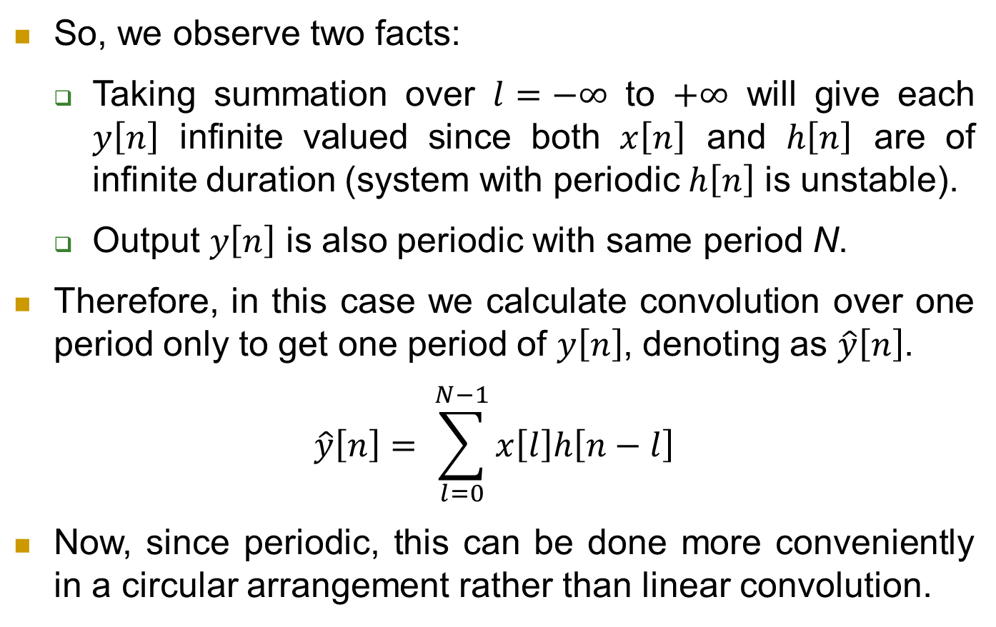
Circular Convolution
So, we observe two facts:
Taking summation over $l=−∞$ to $+∞$ will give each $y\left[n\right]$ infinite valued since both $x\left[n\right]$ and $h\left[n\right]$ are of infinite duration (system with periodic $h\left[n\right]$ is unstable).
Output $y\left[n\right]$ is also periodic with same period N.
Therefore, in this case we calculate convolution over one period only to get one period of $y\left[n\right]$, denoting as $\hat{y}\left[n\right]$.
$$\hat{y}\left[n\right]= \sum_{l=0}^{N−1}{x\left[l\right]h\left[n−l\right]}$$
Now, since periodic, this can be done more conveniently in a circular arrangement rather than linear convolution.

Slide 24

Circular Convolution
Arrange $\hat{x}\left[l\right]$ in anti-clockwise, and then arrange $\hat{h}\left[l\right]$ clockwise to get $\hat{h}\left[−l\right]$; $\hat{x}\left[l\right]$ and $\hat{h}\left[l\right]$ denote only one period of $x\left[n\right]$ and $h\left[n\right]$ and so of finite length N each.
Multiply point-to-point and add to get $\hat{y}\left[0\right].$
Shift $h\left[−l\right]$ by n samples anti-clockwise, n = 1 to N−1, to get $\hat{h}\left[n−l\right]$. Multiply and add to get $\hat{y}\left[n\right].$

Slide 25
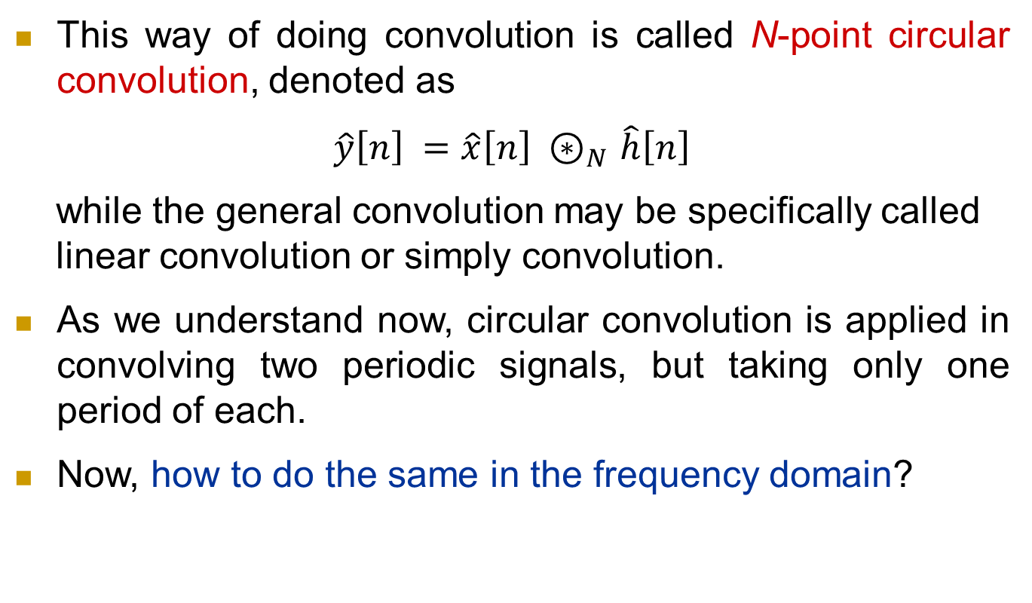
Circular Convolution
This way of doing convolution is called N-point circular convolution, denoted as
$$\hat{y}\left[n\right] =\hat{x}\left[n\right]{ ⊛}_{N }\hat{h}\left[n\right]$$
while the general convolution may be specifically called
linear convolution or simply convolution.
As we understand now, circular convolution is applied in convolving two periodic signals, but taking only one period of each.
Now, how to do the same in the frequency domain?

Slide 26
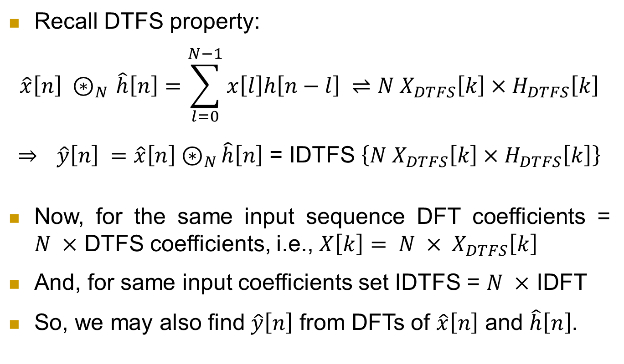
Circular Convolution
Recall DTFS property:
$$\hat{x}\left[n\right]{ ⊛}_{N }\hat{h}\left[n\right]=\sum_{l=0}^{N−1}{x\left[l\right]h\left[n−l\right]} ⇌N X_{DTFS}\left[k\right]×H_{DTFS}\left[k\right]$$
⇒ $\hat{y}\left[n\right] =\hat{x}\left[n\right]{ ⊛}_{N }\hat{h}\left[n\right]$ = IDTFS $\left\{N X_{DTFS}\left[k\right]×H_{DTFS}\left[k\right]\right\}$
Now, for the same input sequence DFT coefficients = $N ×$ DTFS coefficients, i.e., $X\left[k\right]$ $= {N × X}_{DTFS}\left[k\right]$
And, for same input coefficients set IDTFS = $N ×$ IDFT
So, we may also find $\hat{y}\left[n\right]$ from DFTs of $\hat{x}\left[n\right]$ and $\hat{h}\left[n\right]$.

Slide 27
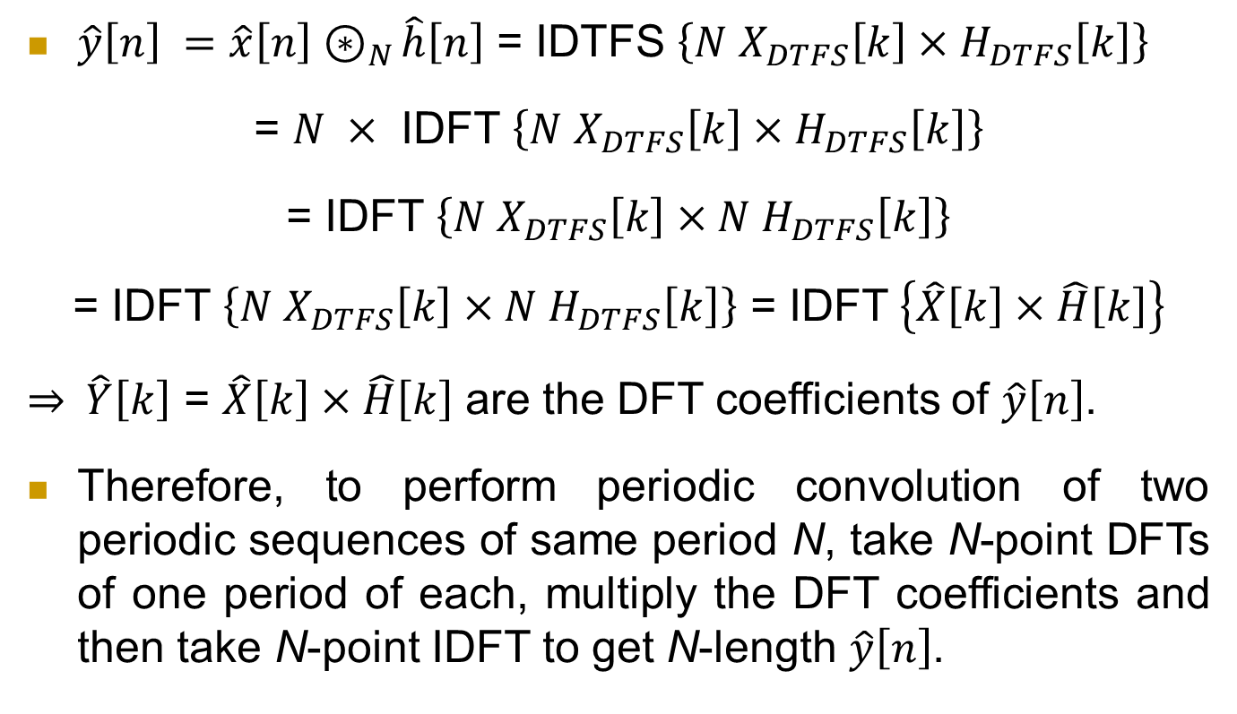
Circular Convolution
$\hat{y}\left[n\right] =\hat{x}\left[n\right]{ ⊛}_{N }\hat{h}\left[n\right]$ = IDTFS $\left\{N X_{DTFS}\left[k\right]×H_{DTFS}\left[k\right]\right\}$
= $N ×$ IDFT $\left\{N X_{DTFS}\left[k\right]×H_{DTFS}\left[k\right]\right\}$
= IDFT $\left\{N X_{DTFS}\left[k\right]×{N H}_{DTFS}\left[k\right]\right\}$
= IDFT $\left\{N X_{DTFS}\left[k\right]×{N H}_{DTFS}\left[k\right]\right\}$ = IDFT $\left\{\hat{X}\left[k\right]×\hat{H}\left[k\right]\right\}$
⇒ $\hat{Y}\left[k\right]$ = $\hat{X}\left[k\right]×\hat{H}\left[k\right]$ are the DFT coefficients of $\hat{y}\left[n\right]$.
Therefore, to perform periodic convolution of two periodic sequences of same period N, take N-point DFTs of one period of each, multiply the DFT coefficients and then take N-point IDFT to get N-length $\hat{y}\left[n\right]$.

Slide 28
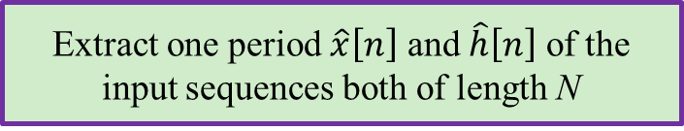
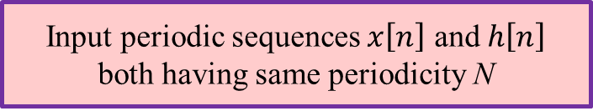
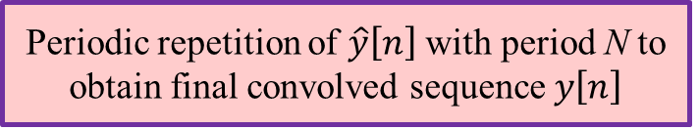
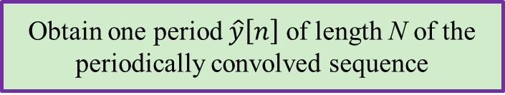
Periodic Convolution
Input periodic sequences $x\left[n\right]$ and $h\left[n\right]$ both having same periodicity N
Extract one period $\hat{x}\left[n\right]$ and $\hat{h}\left[n\right]$ of the input sequences both of length N
Periodic convolution
DTFS and inverse DTFS
N-point circular convolution
N-point DFT, multiply and IDFT
Obtain one period $\hat{y}\left[n\right]$ of length N of the periodically convolved sequence
Periodic repetition of $\hat{y}\left[n\right]$ with period N to obtain final convolved sequence $y\left[n\right]$

Slide 29
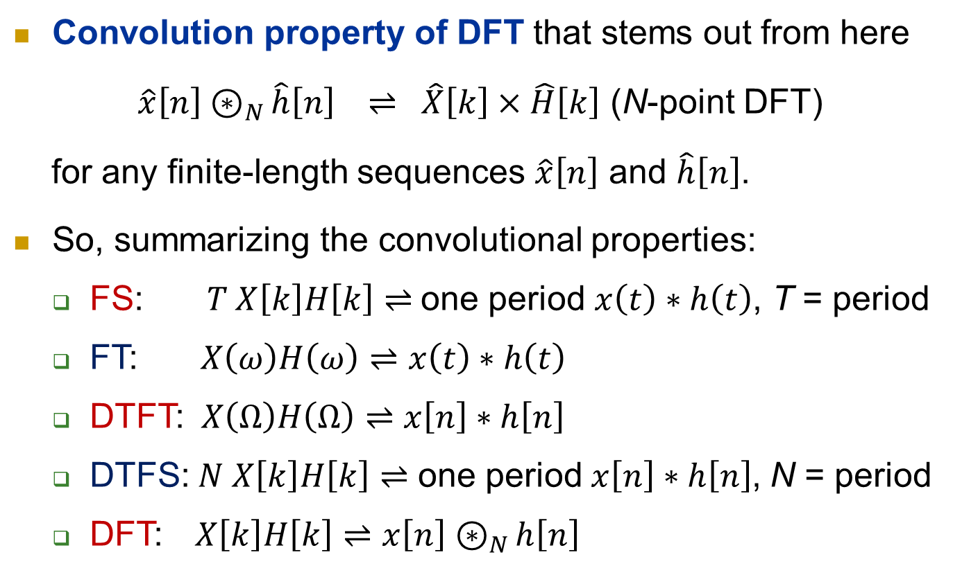
Convolution Property
Convolution property of DFT that stems out from here
$\hat{x}\left[n\right]{ ⊛}_{N }\hat{h}\left[n\right] ⇌ \hat{X}\left[k\right]×\hat{H}\left[k\right]$ (N-point DFT)
for any finite-length sequences $\hat{x}\left[n\right]$ and $\hat{h}\left[n\right]$.
So, summarizing the convolutional properties:
FS: $T X\left[k\right]H\left[k\right]⇌$one period $x\left(t\right)∗h\left(t\right)$, T = period
FT: $X\left(ω\right)H\left(ω\right)⇌x\left(t\right)∗h\left(t\right)$
DTFT: $X\left(Ω\right)H\left(Ω\right)⇌x\left[n\right]∗h\left[n\right]$
DTFS:$N X\left[k\right]H\left[k\right]⇌$ one period$x\left[n\right]∗h\left[n\right]$, N = period
DFT: $X\left[k\right]H\left[k\right]⇌$ $x\left[n\right]{ ⊛}_{N }h\left[n\right]$

Slide 30
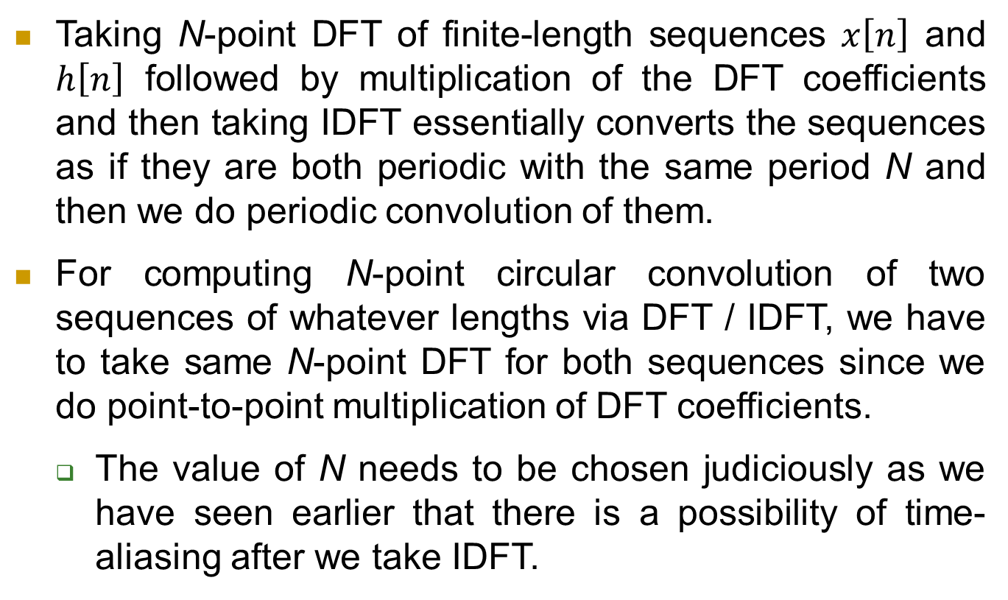
Convolution Property
Taking N-point DFT of finite-length sequences $x\left[n\right]$ and $h\left[n\right]$ followed by multiplication of the DFT coefficients and then taking IDFT essentially converts the sequences as if they are both periodic with the same period N and then we do periodic convolution of them.
For computing N-point circular convolution of two sequences of whatever lengths via DFT / IDFT, we have to take same N-point DFT for both sequences since we do point-to-point multiplication of DFT coefficients.
The value of N needs to be chosen judiciously as we have seen earlier that there is a possibility of time-aliasing after we take IDFT.

Slide 31
Circular Convolution contd.
Observe that for doing circular convolution, both the sequences must be of same length since we are doing point-to-point multiplication (this is not a necessary condition in linear convolution).
Both sequences must be of length N to apply N-point circular convolution on them.
If not we have to do something appropriate to make them equal length sequences.
In the case discussed we have taken both sequences of same periodicity and so there was no problem.
Now we will take up other cases.

Slide 32

Circular Convolution contd.
Both $x\left[n\right]$ and $h\left[n\right]$ are periodic but with different periods N₁ and N₂ –
Take N = LCM (N₁, N₂)
$x\left[n\right]$ periodic with period N and $h\left[n\right]$ non-periodic with length L, where N ≥ L –

Slide 33
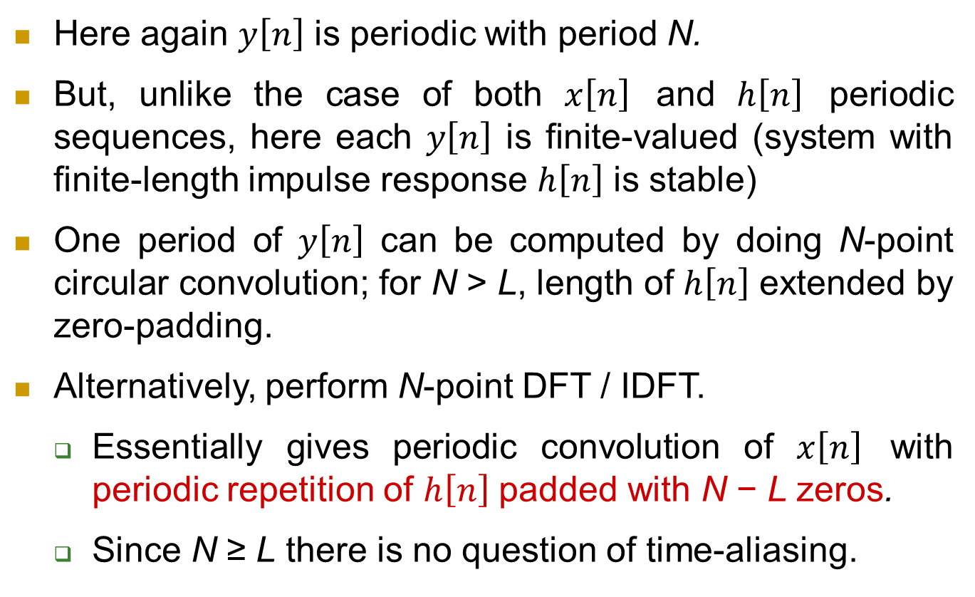
Circular Convolution contd.
Here again $y\left[n\right]$ is periodic with period N.
But, unlike the case of both $x\left[n\right]$ and $h\left[n\right]$ periodic sequences, here each $y\left[n\right]$ is finite-valued (system with finite-length impulse response $h\left[n\right]$ is stable)
One period of $y\left[n\right]$ can be computed by doing N-point circular convolution; for N > L, length of $h\left[n\right]$ extended by zero-padding.
Alternatively, perform N-point DFT / IDFT.
Essentially gives periodic convolution of $x\left[n\right]$ with periodic repetition of $h\left[n\right]$ padded with N − L zeros.
Since N ≥ L there is no question of time-aliasing.

Slide 34

Circular Convolution contd.
$x\left[n\right]$ periodic with period N and $h\left[n\right]$ non-periodic with length L, where N < L –
$$\hat{y}\left[0\right]=x\left[0\right]\left(h\left[0\right]+h\left[4\right]\right)+x\left[3\right]\left(h\left[1\right]+h\left[5\right]\right)+x\left[2\right]h\left[2\right]+x\left[1\right]h\left[3\right]$$
$$\hat{y}\left[1\right]=x\left[3\right]\left(h\left[0\right]+h\left[4\right]\right)+x\left[2\right]\left(h\left[1\right]+h\left[5\right]\right)+x\left[1\right]h\left[2\right]+x\left[0\right]h\left[3\right]$$
$$\hat{y}\left[2\right]=x\left[2\right]\left(h\left[0\right]+h\left[4\right]\right)+x\left[1\right]\left(h\left[1\right]+h\left[5\right]\right)+x\left[0\right]h\left[2\right]+x\left[3\right]h\left[3\right]$$
$$\hat{y}\left[3\right]=x\left[1\right]\left(h\left[0\right]+h\left[4\right]\right)+x\left[0\right]\left(h\left[1\right]+h\left[5\right]\right)+x\left[3\right]h\left[2\right]+x\left[2\right]h\left[3\right]$$

Slide 35

Circular Convolution contd.
So, here also one period of $y\left[n\right]$ can be computed by doing N-point circular convolution. Since, length of $h\left[n\right]$ is more than N, $h\left[n\right]$ is time-aliased as follows.

Slide 36
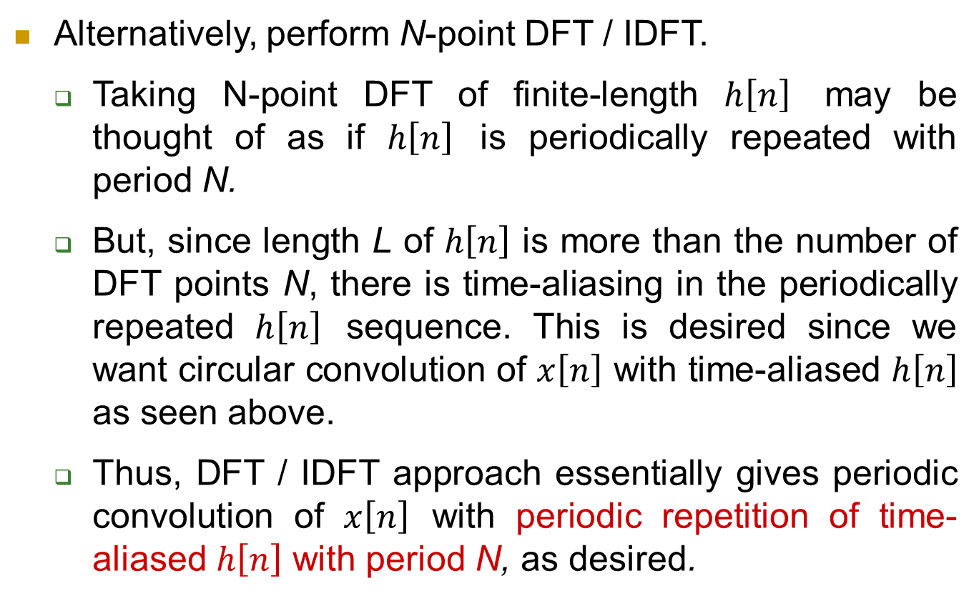
Circular Convolution contd.
Alternatively, perform N-point DFT / IDFT.
Taking N-point DFT of finite-length $h\left[n\right]$ may be thought of as if $h\left[n\right]$ is periodically repeated with period N.
But, since length L of $h\left[n\right]$ is more than the number of DFT points N, there is time-aliasing in the periodically repeated $h\left[n\right]$ sequence. This is desired since we want circular convolution of $x\left[n\right]$ with time-aliased $h\left[n\right]$ as seen above.
Thus, DFT / IDFT approach essentially gives periodic convolution of $x\left[n\right]$ with periodic repetition of time-aliased $h\left[n\right]$ with period N, as desired.

Slide 37
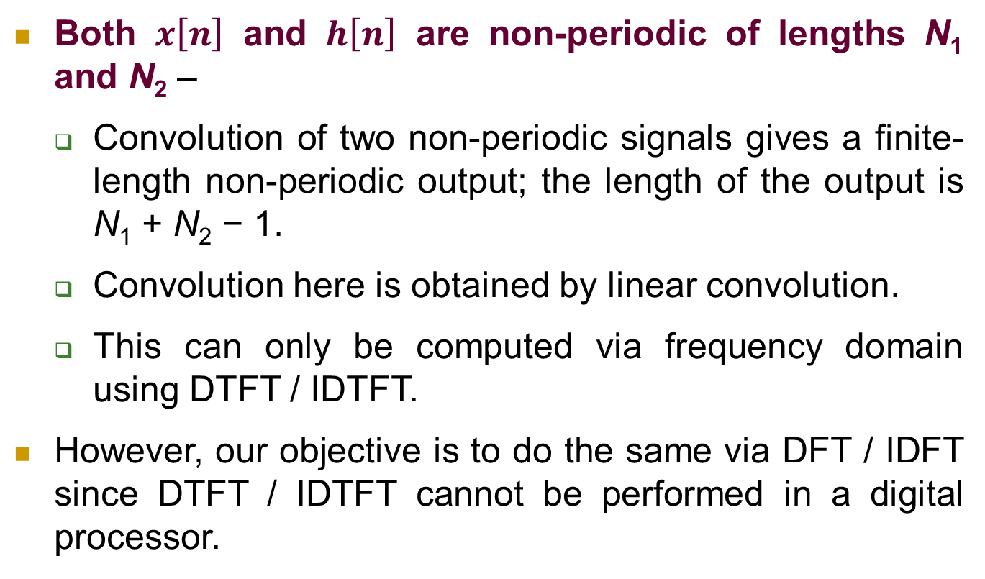
Circular Convolution contd.
Both $x\left[n\right]$ and $h\left[n\right]$ are non-periodic of lengths N₁ and N₂ –
Convolution of two non-periodic signals gives a finite-length non-periodic output; the length of the output is N₁ + N₂ − 1.
Convolution here is obtained by linear convolution.
This can only be computed via frequency domain using DTFT / IDTFT.
However, our objective is to do the same via DFT / IDFT since DTFT / IDTFT cannot be performed in a digital processor.

Slide 38
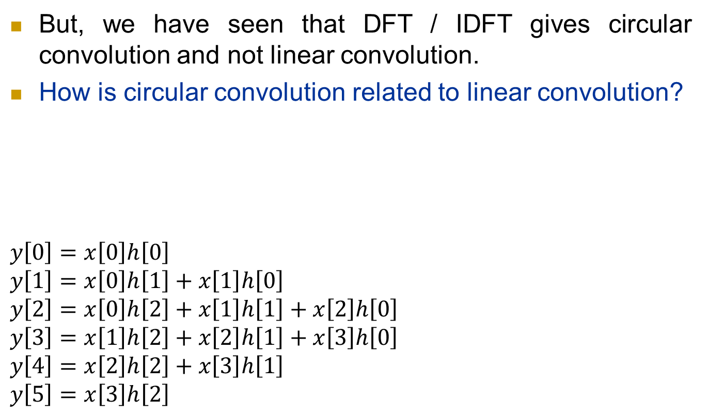
Circular Convolution contd.
But, we have seen that DFT / IDFT gives circular convolution and not linear convolution.
How is circular convolution related to linear convolution?
$$y\left[0\right]=x\left[0\right]h\left[0\right]$$
$$y\left[1\right]=x\left[0\right]h\left[1\right]+x\left[1\right]h\left[0\right]$$
$$y\left[2\right]=x\left[0\right]h\left[2\right]+x\left[1\right]h\left[1\right]+x\left[2\right]h\left[0\right]$$
$$y\left[3\right]=x\left[1\right]h\left[2\right]+x\left[2\right]h\left[1\right]+x\left[3\right]h\left[0\right]$$
$$y\left[4\right]=x\left[2\right]h\left[2\right]+x\left[3\right]h\left[1\right]$$
$$y\left[5\right]=x\left[3\right]h\left[2\right]$$

Slide 39

Circular Convolution contd.
Now, we compare this linear convolution to N-point circular convolution for different values of N.
So, for N = 8,
circular convolution
= linear convolution
$$y\left[0\right]=x\left[0\right]h\left[0\right]$$
$$y\left[1\right]=x\left[0\right]h\left[1\right]+x\left[1\right]h\left[0\right]$$
$$y\left[2\right]=x\left[0\right]h\left[2\right]+x\left[1\right]h\left[1\right]+x\left[2\right]h\left[0\right]$$
$$y\left[3\right]=x\left[1\right]h\left[2\right]+x\left[2\right]h\left[1\right]+x\left[3\right]h\left[0\right]$$
$$y\left[4\right]=x\left[2\right]h\left[2\right]+x\left[3\right]h\left[1\right]$$
$$y\left[5\right]=x\left[3\right]h\left[2\right]$$

Slide 40
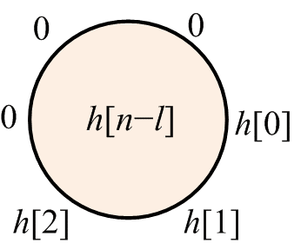
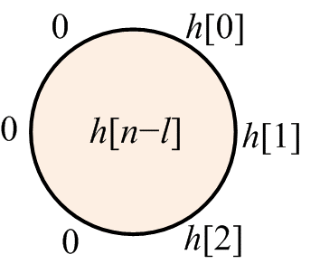
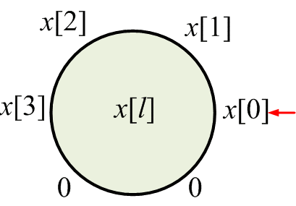
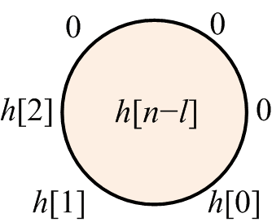
Circular Convolution contd.
Now, we compare this linear convolution to N-point circular convolution for different values of N.
So, for N = 6,
circular convolution
= linear convolution
$$y\left[0\right]=x\left[0\right]h\left[0\right]$$
$$y\left[1\right]=x\left[0\right]h\left[1\right]+x\left[1\right]h\left[0\right]$$
$$y\left[2\right]=x\left[0\right]h\left[2\right]+x\left[1\right]h\left[1\right]+x\left[2\right]h\left[0\right]$$
$$y\left[3\right]=x\left[1\right]h\left[2\right]+x\left[2\right]h\left[1\right]+x\left[3\right]h\left[0\right]$$
$$y\left[4\right]=x\left[2\right]h\left[2\right]+x\left[3\right]h\left[1\right]$$
$$y\left[5\right]=x\left[3\right]h\left[2\right]$$

Slide 41
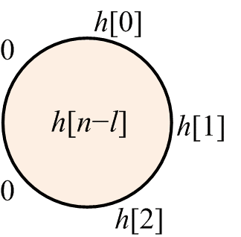
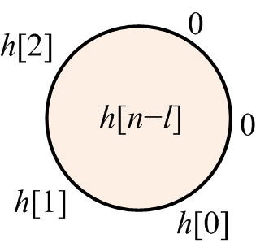
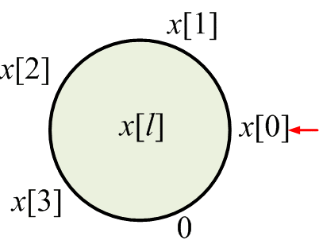
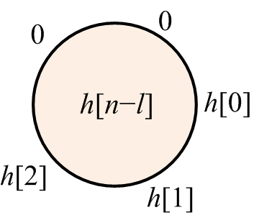

Circular Convolution contd.
Now, we compare this linear convolution to N-point circular convolution for different values of N.
So, for N = 5,
circular convolution
= $y\left[0\right]$+$y\left[5\right]$, $y\left[1\right]$, $y\left[2\right]$, $y\left[3\right]$, $y\left[4\right]$
$$y\left[0\right]=x\left[0\right]h\left[0\right]$$
$$y\left[1\right]=x\left[0\right]h\left[1\right]+x\left[1\right]h\left[0\right]$$
$$y\left[2\right]=x\left[0\right]h\left[2\right]+x\left[1\right]h\left[1\right]+x\left[2\right]h\left[0\right]$$
$$y\left[3\right]=x\left[1\right]h\left[2\right]+x\left[2\right]h\left[1\right]+x\left[3\right]h\left[0\right]$$
$$y\left[4\right]=x\left[2\right]h\left[2\right]+x\left[3\right]h\left[1\right]$$
$$y\left[5\right]=x\left[3\right]h\left[2\right]$$

Slide 42
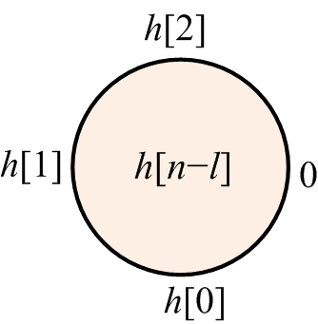
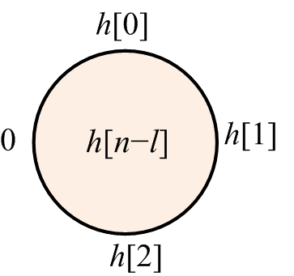
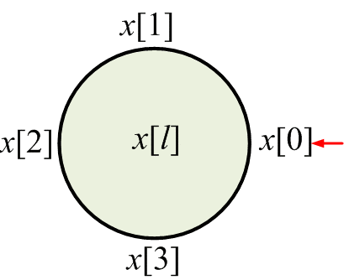
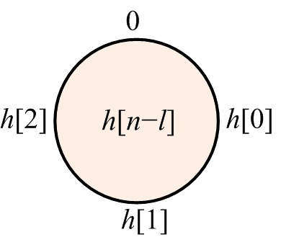

Circular Convolution contd.
Now, we compare this linear convolution to N-point circular convolution for different values of N.
So, for N = 4,
circular convolution
= $y\left[0\right]$+$y\left[4\right]$, $y\left[1\right]$+$y\left[5\right]$, $y\left[2\right]$, $y\left[3\right]$
$$y\left[0\right]=x\left[0\right]h\left[0\right]$$
$$y\left[1\right]=x\left[0\right]h\left[1\right]+x\left[1\right]h\left[0\right]$$
$$y\left[2\right]=x\left[0\right]h\left[2\right]+x\left[1\right]h\left[1\right]+x\left[2\right]h\left[0\right]$$
$$y\left[3\right]=x\left[1\right]h\left[2\right]+x\left[2\right]h\left[1\right]+x\left[3\right]h\left[0\right]$$
$$y\left[4\right]=x\left[2\right]h\left[2\right]+x\left[3\right]h\left[1\right]$$
$$y\left[5\right]=x\left[3\right]h\left[2\right]$$

Slide 43

Circular Convolution contd.
For M ≠ N, N-point circular convolution is different from M-point circular convolution.
Circular convolution can be derived from linear convolution $y\left[n\right]=x\left[n\right]∗ h\left[n\right]$ as linear convolution + time-aliasing. That is,
$\hat{x}\left[n\right]{ ⊛}_{N }\hat{h}\left[n\right]$ = one period of $\sum_{m=−∞}^{+∞}{y\left[n+mN\right]}$
On the other hand, y[n] can be obtained from circular convolution if there is no time aliasing. And, to avoid time aliasing, N ≥ N₁ + N₂ − 1.
Thus, linear convolution of two finite length sequences can be obtained via DFT / IDFT if N is taken as above.

Slide 44

Summarizing
Both $x\left[n\right]$ and $h\left[n\right]$ are periodic with same period N (or N = lcm[N₁, N₂] ): General linear convolution $x\left[n\right]∗h\left[n\right]$ not valid; compute one period of periodic convolution
via N-point circular convolution of $\hat{x}\left[n\right]$ and $\hat{h}\left[n\right]$.
via N-point DFT / IDFT of $\hat{x}\left[n\right]$ and $\hat{h}\left[n\right]$.
via linear convolution followed by time-aliasing – perform linear convolution giving output sequence of length 2N − 1, then overlap last N − 1 output samples with the first N − 1 output samples resulting in the required N-length one period of the periodic convolution.

Slide 45

Summarizing
$x\left[n\right]$ periodic with period N but $h\left[n\right]$ is of finite-length L: Compute one period of linear convolution $x\left[n\right]∗h\left[n\right]$
via N-point circular convolution of $\hat{x}\left[n\right]$ and $\hat{h}\left[n\right]$; for L = N, $\hat{h}\left[n\right]$ = $h\left[n\right]$, for L < N, $h\left[n\right]$ is zero-padded and for L > N, $h\left[n\right]$ is time-aliased to make $\hat{h}\left[n\right]$ N-length long.
via N-point DFT / IDFT of $\hat{x}\left[n\right]$ and $h\left[n\right]$.
via linear convolution followed by time-aliasing.
Note that here taking the convolution sum over $l=−∞$ to $+∞$ is as good as taking the sum over finite length L. So, here circular convolution gives one period of the actual linear convolution $x\left[n\right]∗h\left[n\right]$.

Slide 46

Summarizing
Both $x\left[n\right]$ and $h\left[n\right]$ are non-periodic of lengths N₁ and N₂: Compute Linear convolution $x\left[n\right]∗h\left[n\right]$ computed
via linear convolution as usual.
via N-point circular convolution of $x\left[n\right]$ and $h\left[n\right]$, where we take N ≥ N₁ + N₂ − 1.
via N-point DFT / IDFT of $x\left[n\right]$ and $h\left[n\right]$.

